Slide 1
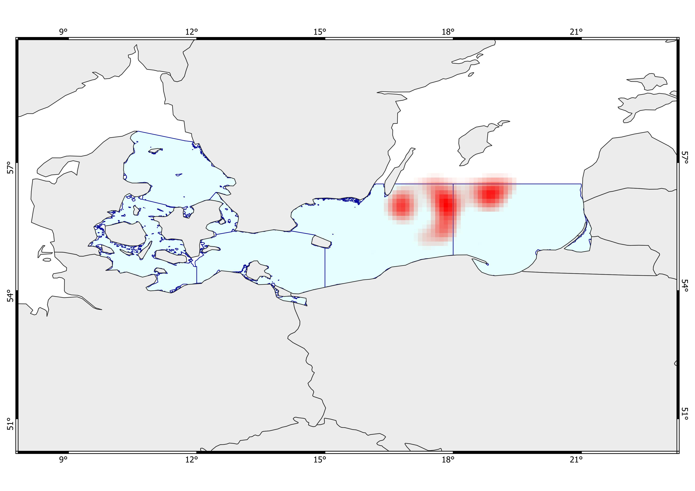
1
3
2
4
Ecosystem Risk Assessment
Multi K-means
- All species -
Deep, cold areas with very low bottom oxygen, moderate to high salinity, and low surface productivity. Very high biomass. Fishing activity is low to fair, and shipping traffic is moderate. Strong anthropogenic influence with a marked presence of dumping sites and very few wind farms.
Very deep, cold areas with extremely low bottom oxygen, low bottom salinity, and quite low surface productivity. Very high biomass. Fair to moderate fishing activity, and fair shipping traffic. Minor anthropogenic influence with the presence of wind farms.
Relatively shallow, very cold areas with moderately low bottom oxygen and very low bottom salinity, and low surface productivity. Very high biomass. Fair fishing activity and moderate shipping traffic. Moderate to high anthropogenic influence, with dumping sites and wind farms.
Very deep, cold areas with extremely low bottom oxygen and fair surface productivity. Very high biomass, low salinity, slightly high fishing activity, moderate shipping traffic, and the presence of wind farms.

Slide 2
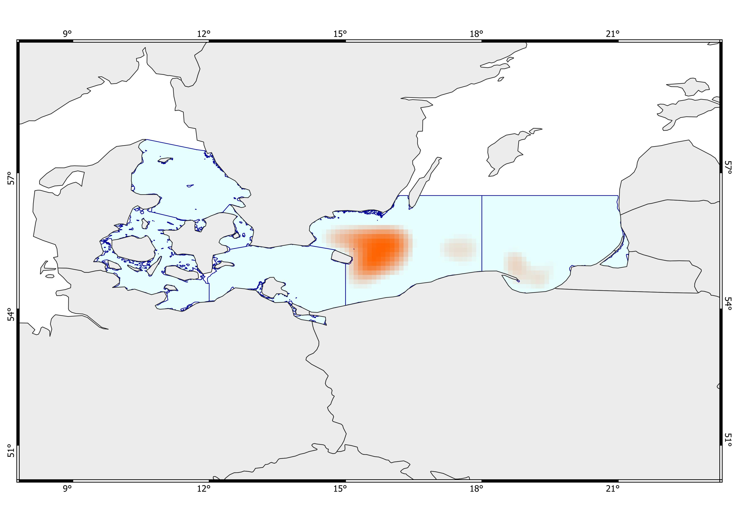
1
3
2
Ecosystem Risk Assessment
Multi K-means
- Five species -
Very deep, cold areas with extremely low bottom oxygen and very low surface productivity. Very high biomass of five commercial demersal species, high salinity, high fishing activity, and fair shipping traffic. Strong anthropogenic influence with a dominant presence of dumping sites and minor military areas and wind farms.
Very deep, cold areas with low bottom oxygen and fair surface productivity. Very high biomass of five commercial demersal species, extremely high fishing activity, moderate shipping traffic, and moderate salinity, with minor presence of military areas.
Very deep, cold areas with low bottom oxygen and fair surface productivity. Very high biomass of five commercial demersal species, very high fishing activity, moderate shipping traffic, and low/fair salinity.

Slide 3
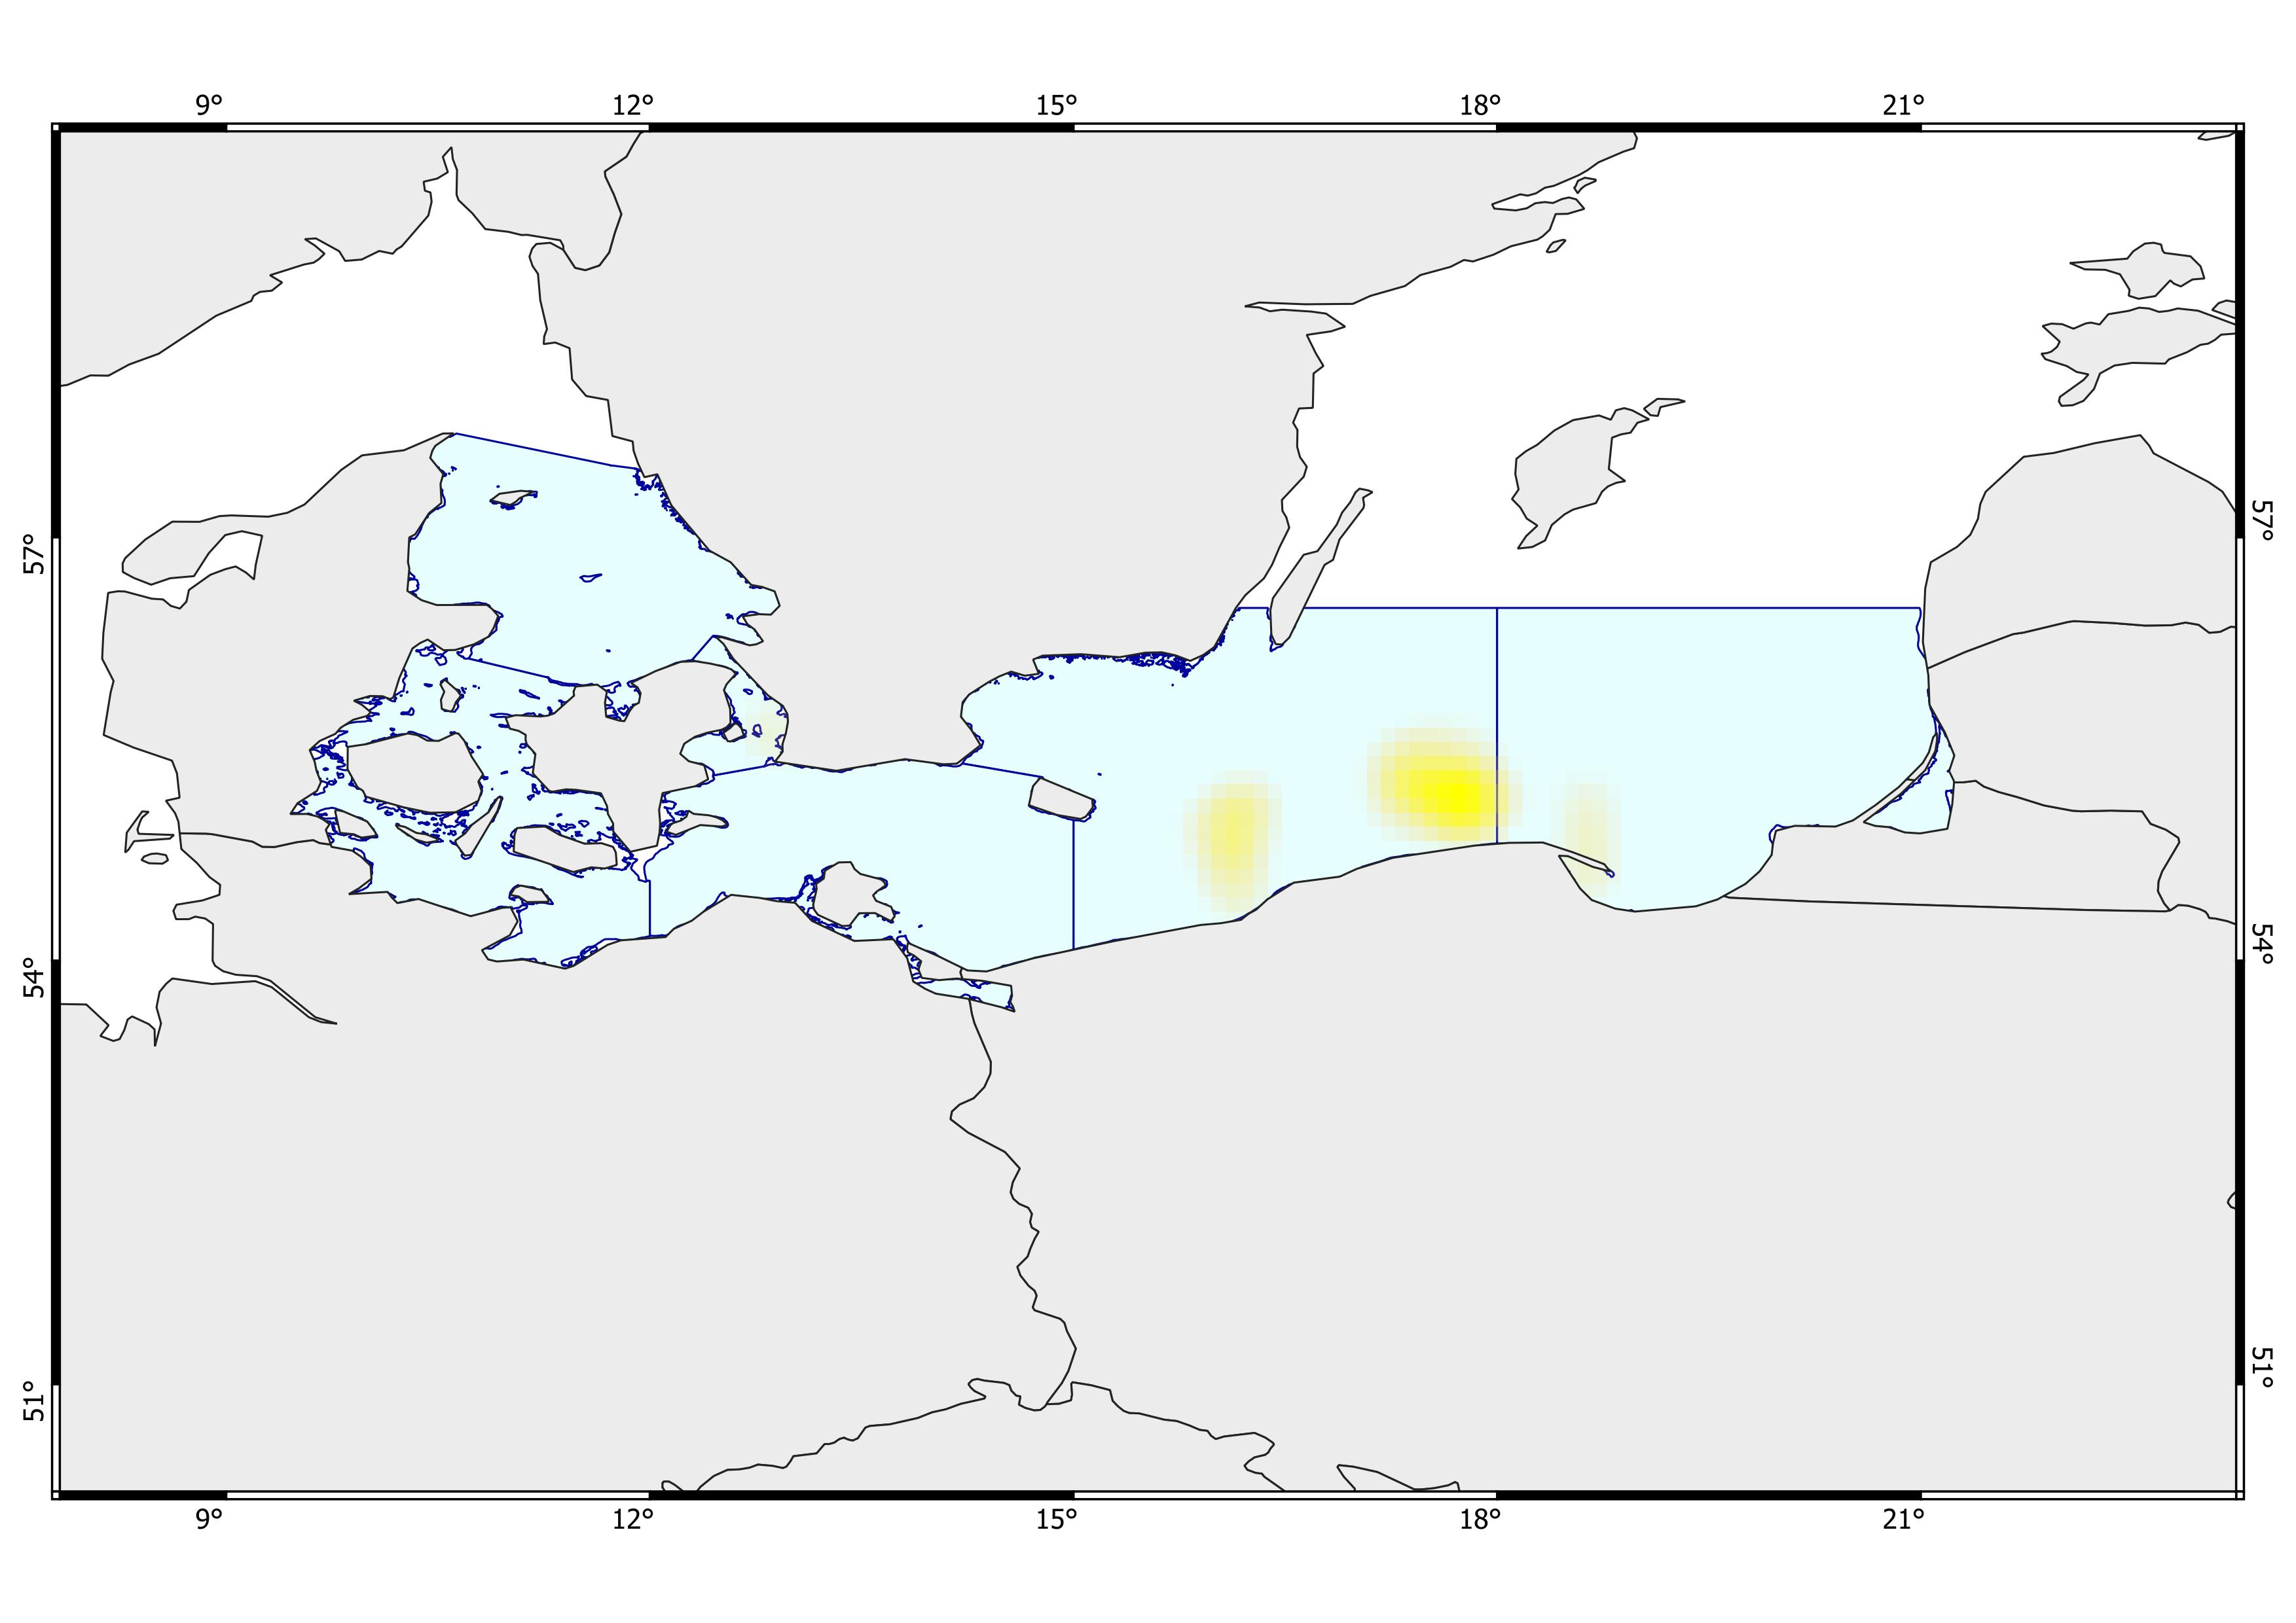
1
2
3
2
Ecosystem Risk Assessment
Multi K-means
- Gadus morhua -
Shallow, warm areas with slightly low bottom oxygen and very high surface productivity. Moderate to high biomass of Gadus morhua, moderately high fishing activity, moderate shipping traffic, and moderate salinity. Minor anthropogenic influence with light presence of dumping sites, military areas, and wind farms.
Fairly deep, cool areas with extremely low bottom oxygen and high surface productivity. High biomass of Gadus morhua, moderately high fishing activity, moderate shipping traffic, and fair salinity. Minimal presence of wind farms. Partly hardrock seafloor.
Fairly deep, cool areas with moderately low bottom oxygen and moderate surface productivity. High biomass of Gadus morhua, moderately high fishing activity, moderate shipping traffic, and fair salinity. Minimal anthropogenic influence, with only light presence of dumping sites, military areas, and wind farms. Partly hardrock seafloor.

Slide 4
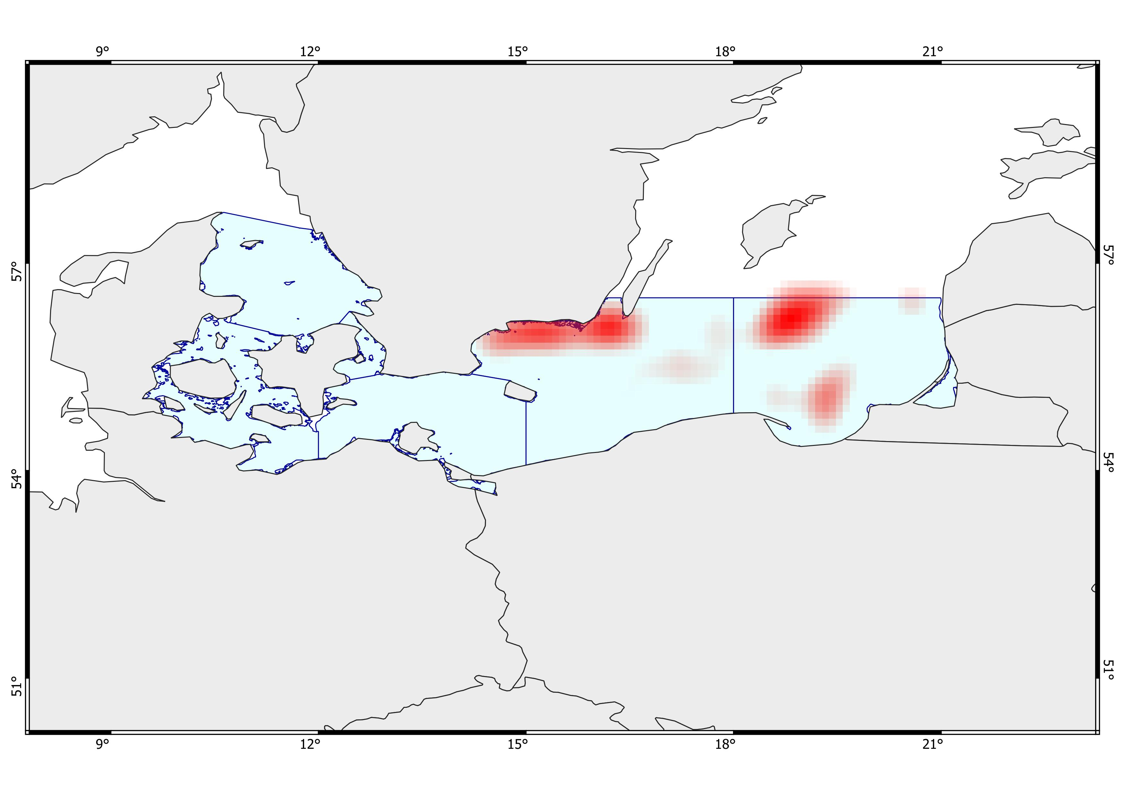
2
1
3
2
4
3
Ecosystem Risk Assessment
VAE (+ Multi K-means)
- All species -
Fairly deep, cold areas with high bottom oxygen and fairly moderate surface productivity. Very high biomass, moderately high fishing activity, moderate shipping traffic, and low salinity. Intense anthropogenic influence, limited to military areas. Partly hardrock seafloor.
Shallow areas with cool bottom waters, very high biomass, and moderate surface productivity. Moderately high fishing activity, moderate shipping traffic, and low salinity, with high bottom oxygen levels. Intense anthropogenic influence, limited to military areas.
Deep, cold areas with low bottom oxygen and low surface productivity. Very high biomass, moderate fishing activity, moderate shipping traffic, and moderate to high salinity. Strong presence of dumping sites and only minimal military influence.
Fairly deep, cold areas with low bottom oxygen and moderate surface productivity. High biomass, moderate to high fishing activity, high shipping traffic, and low salinity. Minimal presence of wind farms.
ABC…..

Slide 5
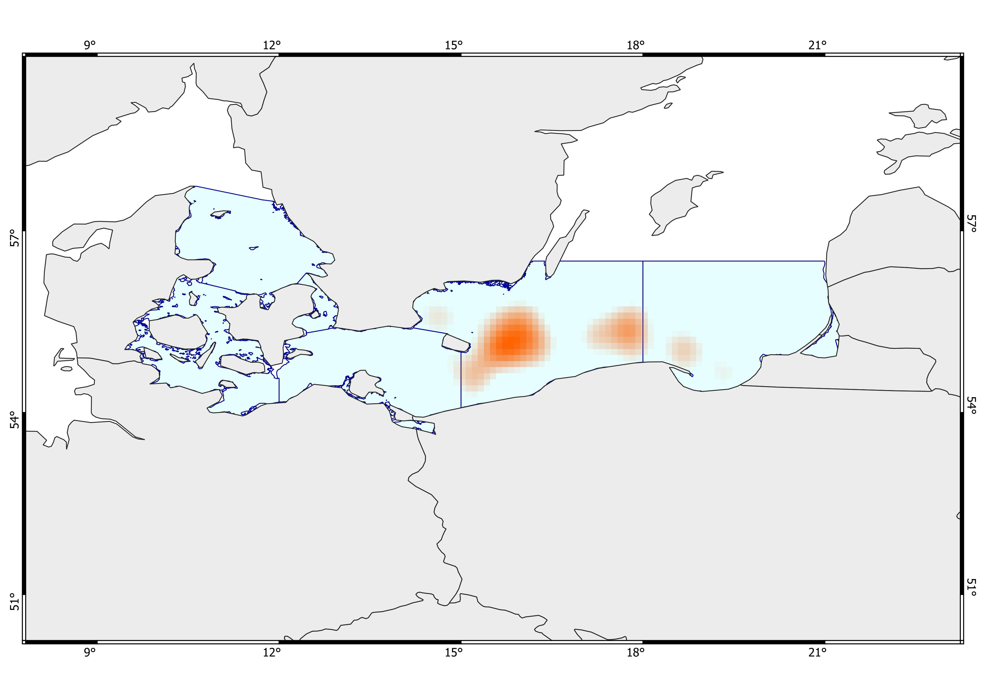
2
1
3
1
Ecosystem Risk Assessment
VAE (+ Multi K-means)
- Five species -
Deep, cold areas with low bottom oxygen and high salinity, and fairly high surface productivity. Very high biomass of five commercial species, intense fishing activity, and moderate shipping traffic. Strong anthropogenic influence with dominant dumping sites, military areas, and minimal presence of wind farms.
Shallow, cool areas with low bottom oxygen and moderately high salinity, and moderate surface productivity. High biomass of five commercial species, intense fishing activity, moderate shipping traffic. Minimal anthropogenic influence, limited to minor military areas and wind farms.
Deep, cold areas with low bottom oxygen and moderately high salinity, and moderate to high surface productivity. High biomass of five commercial species, intense fishing activity, moderate shipping traffic. Minimal anthropogenic influence, with only minor wind farms, and partly hardbottom seafloor.

Slide 6
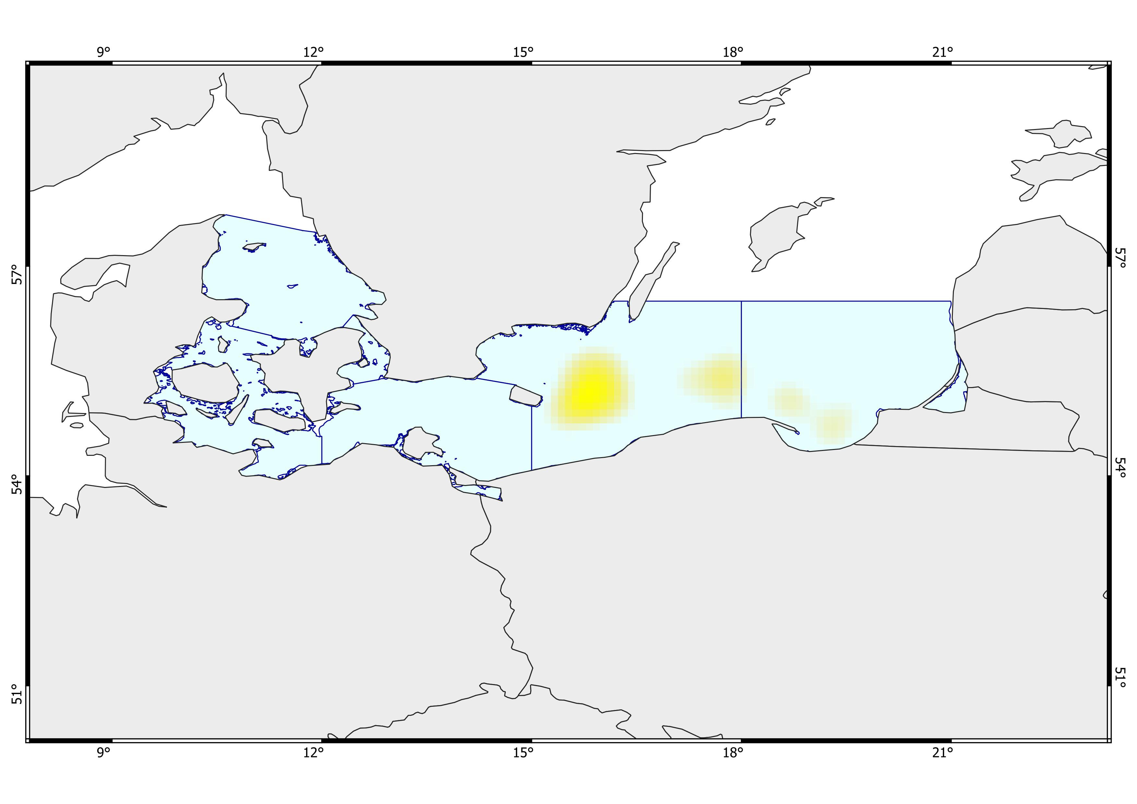
3
2
1
4
Ecosystem Risk Assessment
VAE (+ Multi K-means)
- Gadus morhua -
Deep, very cold areas with extremely low bottom oxygen, moderately high salinity, and high surface productivity. High biomass of Gadus morhua, very intense fishing activity, and heavy shipping traffic.
Deep, very cold areas with high salinity, extremely low bottom oxygen, and high surface productivity. High biomass of Gadus morhua, intense fishing activity, and heavy shipping traffic, with only minimal hard-bottom substrate present.
Deep, cold areas with low bottom oxygen and high salinity, and fairly high surface productivity. Very high biomass of Gadus morhua, very intense fishing activity, and moderate shipping traffic. Strong anthropogenic influence with dominant dumping sites, military areas, and minimal presence of wind farms.
Deep, very cold areas with moderately high salinity, extremely low bottom oxygen and very high surface productivity. High biomass of Gadus morhua, very intense fishing activity and heavy shipping traffic, with only minimal anthropogenic presence from limited military areas.

Slide 7
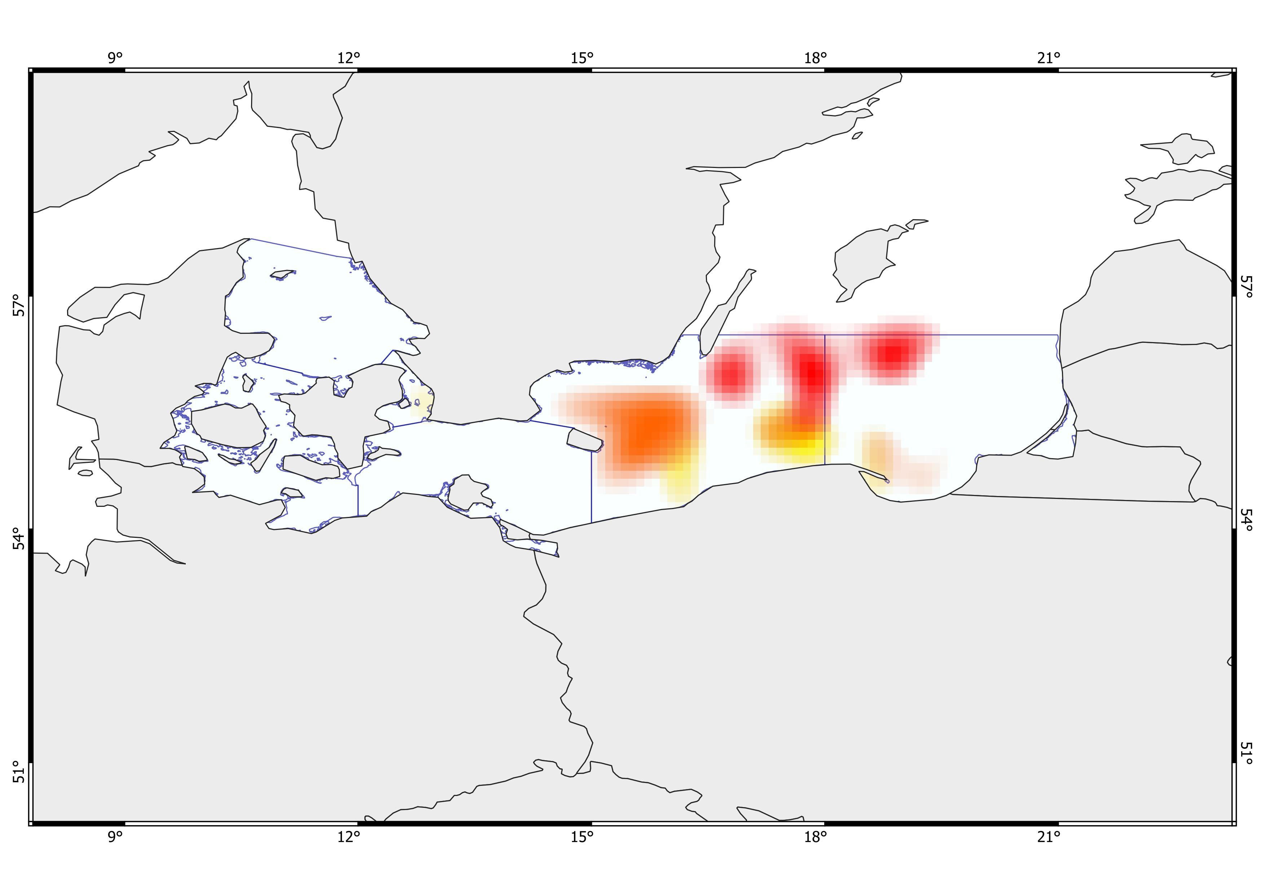
Shallow, warm areas with moderate bottom oxygen, very high salinity, and very high surface productivity. High biomass across the general biodiversity, including Gadus morhua. Moderate fishing activity and moderate to high shipping traffic. Minor anthropogenic influence with minimal presence of wind farms, dumping sites, and military areas. Limited bedrock seabed.
Very deep areas that become shallower toward the southern coast, moderately cold areas, moderate surface productivity, and extremely low bottom oxygen in the central zone, with less severe depletion near the Southern coast. Moderately high salinity. Biomass is generally moderate, high for the five commercially important species, including Gadus morhua. High to very high fishing activity, and shipping traffic from moderate to fairly high. Strong anthropogenic influence with a marked presence of dumping sites and military areas. Limited hard-rock seabed.
Relatively shallow, very cold areas with moderately low bottom oxygen and very low bottom salinity, and low surface productivity. Biomass is generally very high, while the five commercially important species range from moderate to high. Fair fishing activity and moderate shipping traffic. Moderate to high anthropogenic influence, with dumping sites and wind farms.
Very deep, very cold areas with extremely low bottom oxygen, low bottom salinity, and quite low surface productivity. Overall biomass is high, biomass of the five commercially important species is moderate, and Gadus morhua biomass is high. Fishing activity ranges from fair to moderate, and shipping traffic is fair. Minor anthropogenic influence with the presence of wind farms.
Deep, cold areas with very low bottom oxygen, moderate to high salinity, and low surface productivity. Overall biomass is very high, while biomass of the five commercially important species and Gadus morhua is low. Fishing activity is low to fair, and shipping traffic is moderate. Strong anthropogenic influence with a marked presence of dumping sites and very few wind farms.
D
E
C
A
B
F
G
H
Ecosystem Risk Assessment
Multi K-means
- Ensamble -
1

Slide 8
Moderately deep to deep, cold areas with moderately low bottom oxygen and fair to high salinity, and moderate to high surface productivity. Overall biomass is high, with high biomass of the five commercially important species and Gadus morhua. Moderate fishing activity, and fair to moderate shipping traffic. Minor anthropogenic influence with the presence of wind farms. Partly hardbottom seafloor.
Deep, cold areas with moderate to high bottom oxygen depletion and fair to moderate salinity, and high surface productivity. Overall biomass is high, with high biomass of the five commercially important species and Gadus morhua. Fishing activity is high, and shipping traffic ranges from moderate to high. Strong anthropogenic influence with a marked presence of military areas. Minimal hard-bottom seafloor.
Deep, cold areas with very low bottom oxygen, moderate salinity, and high surface productivity. Overall biomass is very high, biomass of the five commercially important species is moderate, and Gadus morhua biomass is high. Fishing activity is very intense, and shipping traffic is fair. Strong anthropogenic influence with a marked presence of military areas.
D
E
C
A
B
F
G
H
Ecosystem Risk Assessment
Multi K-means
- Ensamble -
2

Slide 9
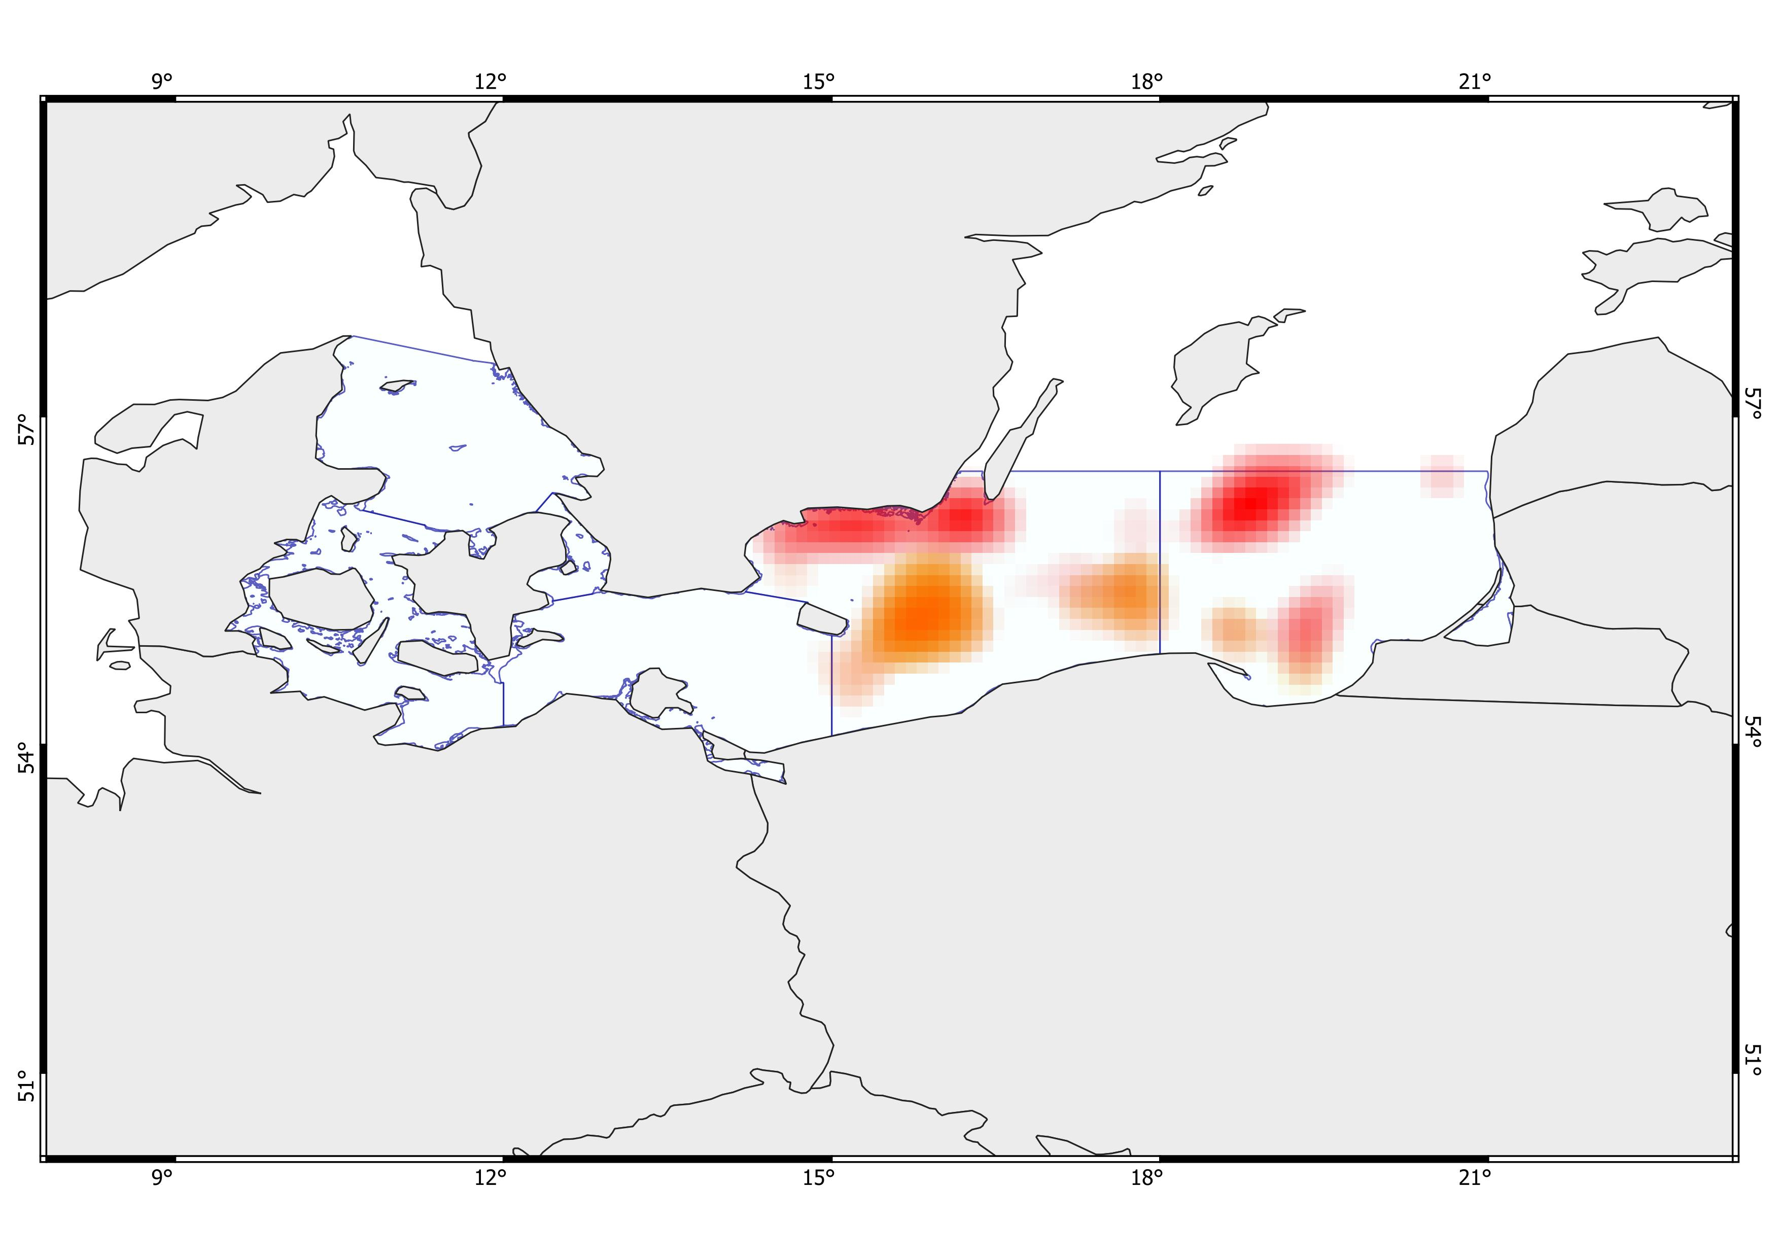
Moderately deep areas with cool to moderately cold bottom temperatures, low bottom salinity, and fair to moderate surface productivity. High bottom oxygen levels. Very high overall biomass, with high biomass of the five commercially important species. Moderate to high fishing activity and fair to moderate shipping traffic. Strong anthropogenic influence, with a marked presence of military areas. Partly hard-rock seafloor.
Moderately deep areas with cold bottom temperatures, low salinity, and low to fairly moderate surface productivity. High bottom oxygen levels. Very high overall biomass, low biomass of the five commercially important species, and moderate biomass of Gadus morhua. Fishing activity ranges from fair to high, and shipping traffic from fair to high. Strong anthropogenic influence with a marked presence of military areas. Presence of hard-bottom seafloor.
(E) Deep, cold areas with very low bottom oxygen, moderate to high salinity, and low surface productivity. Overall biomass is very high, while biomass of the five commercially important species and Gadus morhua is low. Fishing activity is low to fair, and shipping traffic is moderate. Strong anthropogenic influence with a marked presence of dumping sites and very few wind farms.
Shallow areas with moderately cold temperatures, moderate to high surface productivity, low salinity, and very high bottom oxygen levels. Overall biomass ranges from moderate to high, with moderate biomass of the five commercially important species, including Gadus morhua. Fishing activity is low, while shipping traffic is very intense. Strong anthropogenic influence with a marked presence of military areas. Partly hard-bottom seafloor.
O
N
M
N
L
M
L
Q
P
Q
P
R
R
S
S
Ecosystem Risk Assessment
VAE (+ Multi K-means)
- Ensamble -
1

Slide 10
(B) Very deep areas that become shallower toward the southern coast, moderately cold areas, moderate surface productivity, and extremely low bottom oxygen in the central zone, with less severe depletion near the Southern coast. Moderately high salinity. Biomass is generally moderate, high for the five commercially important species, including Gadus morhua. High to very high fishing activity, and shipping traffic from moderate to fairly high. Strong anthropogenic influence with a marked presence of dumping sites and military areas. Limited hard-rock seabed.
(F) Moderately deep to deep, cold areas with moderately low bottom oxygen and fair to high salinity, and moderate to high surface productivity. Overall biomass is high, with high biomass of the five commercially important species and Gadus morhua. Moderate fishing activity, and fair to moderate shipping traffic. Minor anthropogenic influence with the presence of wind farms. Partly hardbottom seafloor.
(G) Deep, cold areas with moderate to high bottom oxygen depletion and fair to moderate salinity, and high surface productivity. Overall biomass is high, with high biomass of the five commercially important species and Gadus morhua. Fishing activity is high, and shipping traffic ranges from moderate to high. Strong anthropogenic influence with a marked presence of military areas. Minimal hard-bottom seafloor.
(H?) Very deep, cold areas with extremely low bottom oxygen, moderate salinity, and moderate to high surface productivity. Overall biomass is fairly moderate, with fair to low biomass of the five commercially important species and moderate biomass of Gadus morhua. Fishing activity is intense, and shipping traffic is high.
O
N
M
N
L
M
L
Q
P
Q
P
R
R
S
S
Ecosystem Risk Assessment
VAE (+ Multi K-means)
- Ensamble -
2

Slide 11
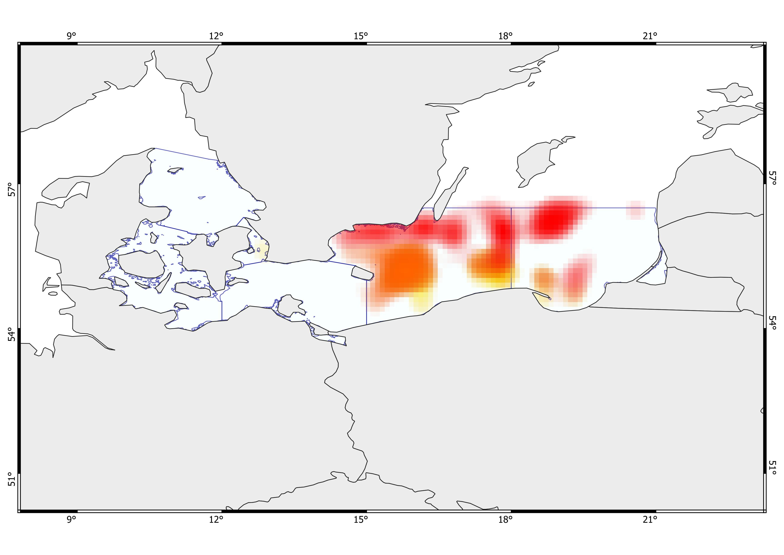
Shallow, warm areas with moderate bottom oxygen, very high salinity, and very high surface productivity. High biomass across the general biodiversity, including Gadus morhua. Moderate fishing activity and moderate to high shipping traffic. Minor anthropogenic influence with minimal presence of wind farms, dumping sites, and military areas. Limited bedrock seabed.
(P) Very deep areas that become shallower toward the southern coast, moderately cold areas, moderate surface productivity, and extremely low bottom oxygen in the central zone, with less severe depletion near the Southern coast. Moderately high salinity. Biomass is generally moderate, high for the five commercially important species, including Gadus morhua. High to very high fishing activity, and shipping traffic from moderate to fairly high. Strong anthropogenic influence with a marked presence of dumping sites and military areas. Limited hard-rock seabed.
Relatively shallow, very cold areas with moderately low bottom oxygen and very low bottom salinity, and low surface productivity. Biomass is generally very high, while the five commercially important species range from moderate to high. Fair fishing activity and moderate shipping traffic. Moderate to high anthropogenic influence, with dumping sites and wind farms.
Very deep, very cold areas with extremely low bottom oxygen, low bottom salinity, and quite low surface productivity. Overall biomass is high, biomass of the five commercially important species is moderate, and Gadus morhua biomass is high. Fishing activity ranges from fair to moderate, and shipping traffic is fair. Minor anthropogenic influence with the presence of wind farms.
(N) Deep, cold areas with very low bottom oxygen, moderate to high salinity, and low surface productivity. Overall biomass is very high, while biomass of the five commercially important species and Gadus morhua is low. Fishing activity is low to fair, and shipping traffic is moderate. Strong anthropogenic influence with a marked presence of dumping sites and very few wind farms.
E
O
L
M
C
D
N
A
B
Q
P
F
R
G
S
H
Ecosystem Risk Assessment
Multi K-means
&
VAE (+ Multi K-means)
- Ensamble -
1

Slide 12
(Q) Moderately deep to deep, cold areas with moderately low bottom oxygen and fair to high salinity, and moderate to high surface productivity. Overall biomass is high, with high biomass of the five commercially important species and Gadus morhua. Moderate fishing activity, and fair to moderate shipping traffic. Minor anthropogenic influence with the presence of wind farms. Partly hardbottom seafloor.
(R) Deep, cold areas with moderate to high bottom oxygen depletion and fair to moderate salinity, and high surface productivity. Overall biomass is high, with high biomass of the five commercially important species and Gadus morhua. Fishing activity is high, and shipping traffic ranges from moderate to high. Strong anthropogenic influence with a marked presence of military areas. Minimal hard-bottom seafloor.
(+S) Deep areas with cold bottom temperatures, moderate salinity, and moderate to very high surface productivity. Extremely low bottom oxygen. Overall biomass ranges from moderate to very high, with fair to moderate biomass of the five commercial species and moderate to moderately high biomass of Gadus morhua. Intense fishing activity, moderate to high shipping traffic.Minor anthropogenic influence with limited presence of military areas.
E
O
L
M
C
D
N
A
B
Q
P
F
R
G
S
H
Moderately deep areas with cool to moderately cold bottom temperatures, low bottom salinity, and fair to moderate surface productivity. High bottom oxygen levels. Very high overall biomass, with high biomass of the five commercially important species. Moderate to high fishing activity and fair to moderate shipping traffic. Strong anthropogenic influence, with a marked presence of military areas. Partly hard-rock seafloor.
Moderately deep areas with cold bottom temperatures, low salinity, and low to fairly moderate surface productivity. High bottom oxygen levels. Very high overall biomass, low biomass of the five commercially important species, and moderate biomass of Gadus morhua. Fishing activity ranges from fair to high, and shipping traffic from fair to high. Strong anthropogenic influence with a marked presence of military areas. Presence of hard-bottom seafloor.
Ecosystem Risk Assessment
Multi K-means
&
VAE (+ Multi K-means)
- Ensamble -
2

Slide 13
Shallow areas with moderately cold temperatures, moderate to high surface productivity, low salinity, and very high bottom oxygen levels. Overall biomass ranges from moderate to high, with moderate biomass of the five commercially important species, including Gadus morhua. Fishing activity is low, while shipping traffic is very intense. Strong anthropogenic influence with a marked presence of military areas. Partly hard-bottom seafloor.
E
O
L
M
C
D
N
A
B
Q
P
F
R
G
S
H
(+H) Deep areas with cold bottom temperatures, moderate salinity, and moderate to very high surface productivity. Extremely low bottom oxygen. Overall biomass ranges from moderate to very high, with fair to moderate biomass of the five commercial species and moderate to moderately high biomass of Gadus morhua. Intense fishing activity, moderate to high shipping traffic.Minor anthropogenic influence with limited presence of military areas.
Ecosystem Risk Assessment
Multi K-means
&
VAE (+ Multi K-means)
- Ensamble -
3

Slide 14
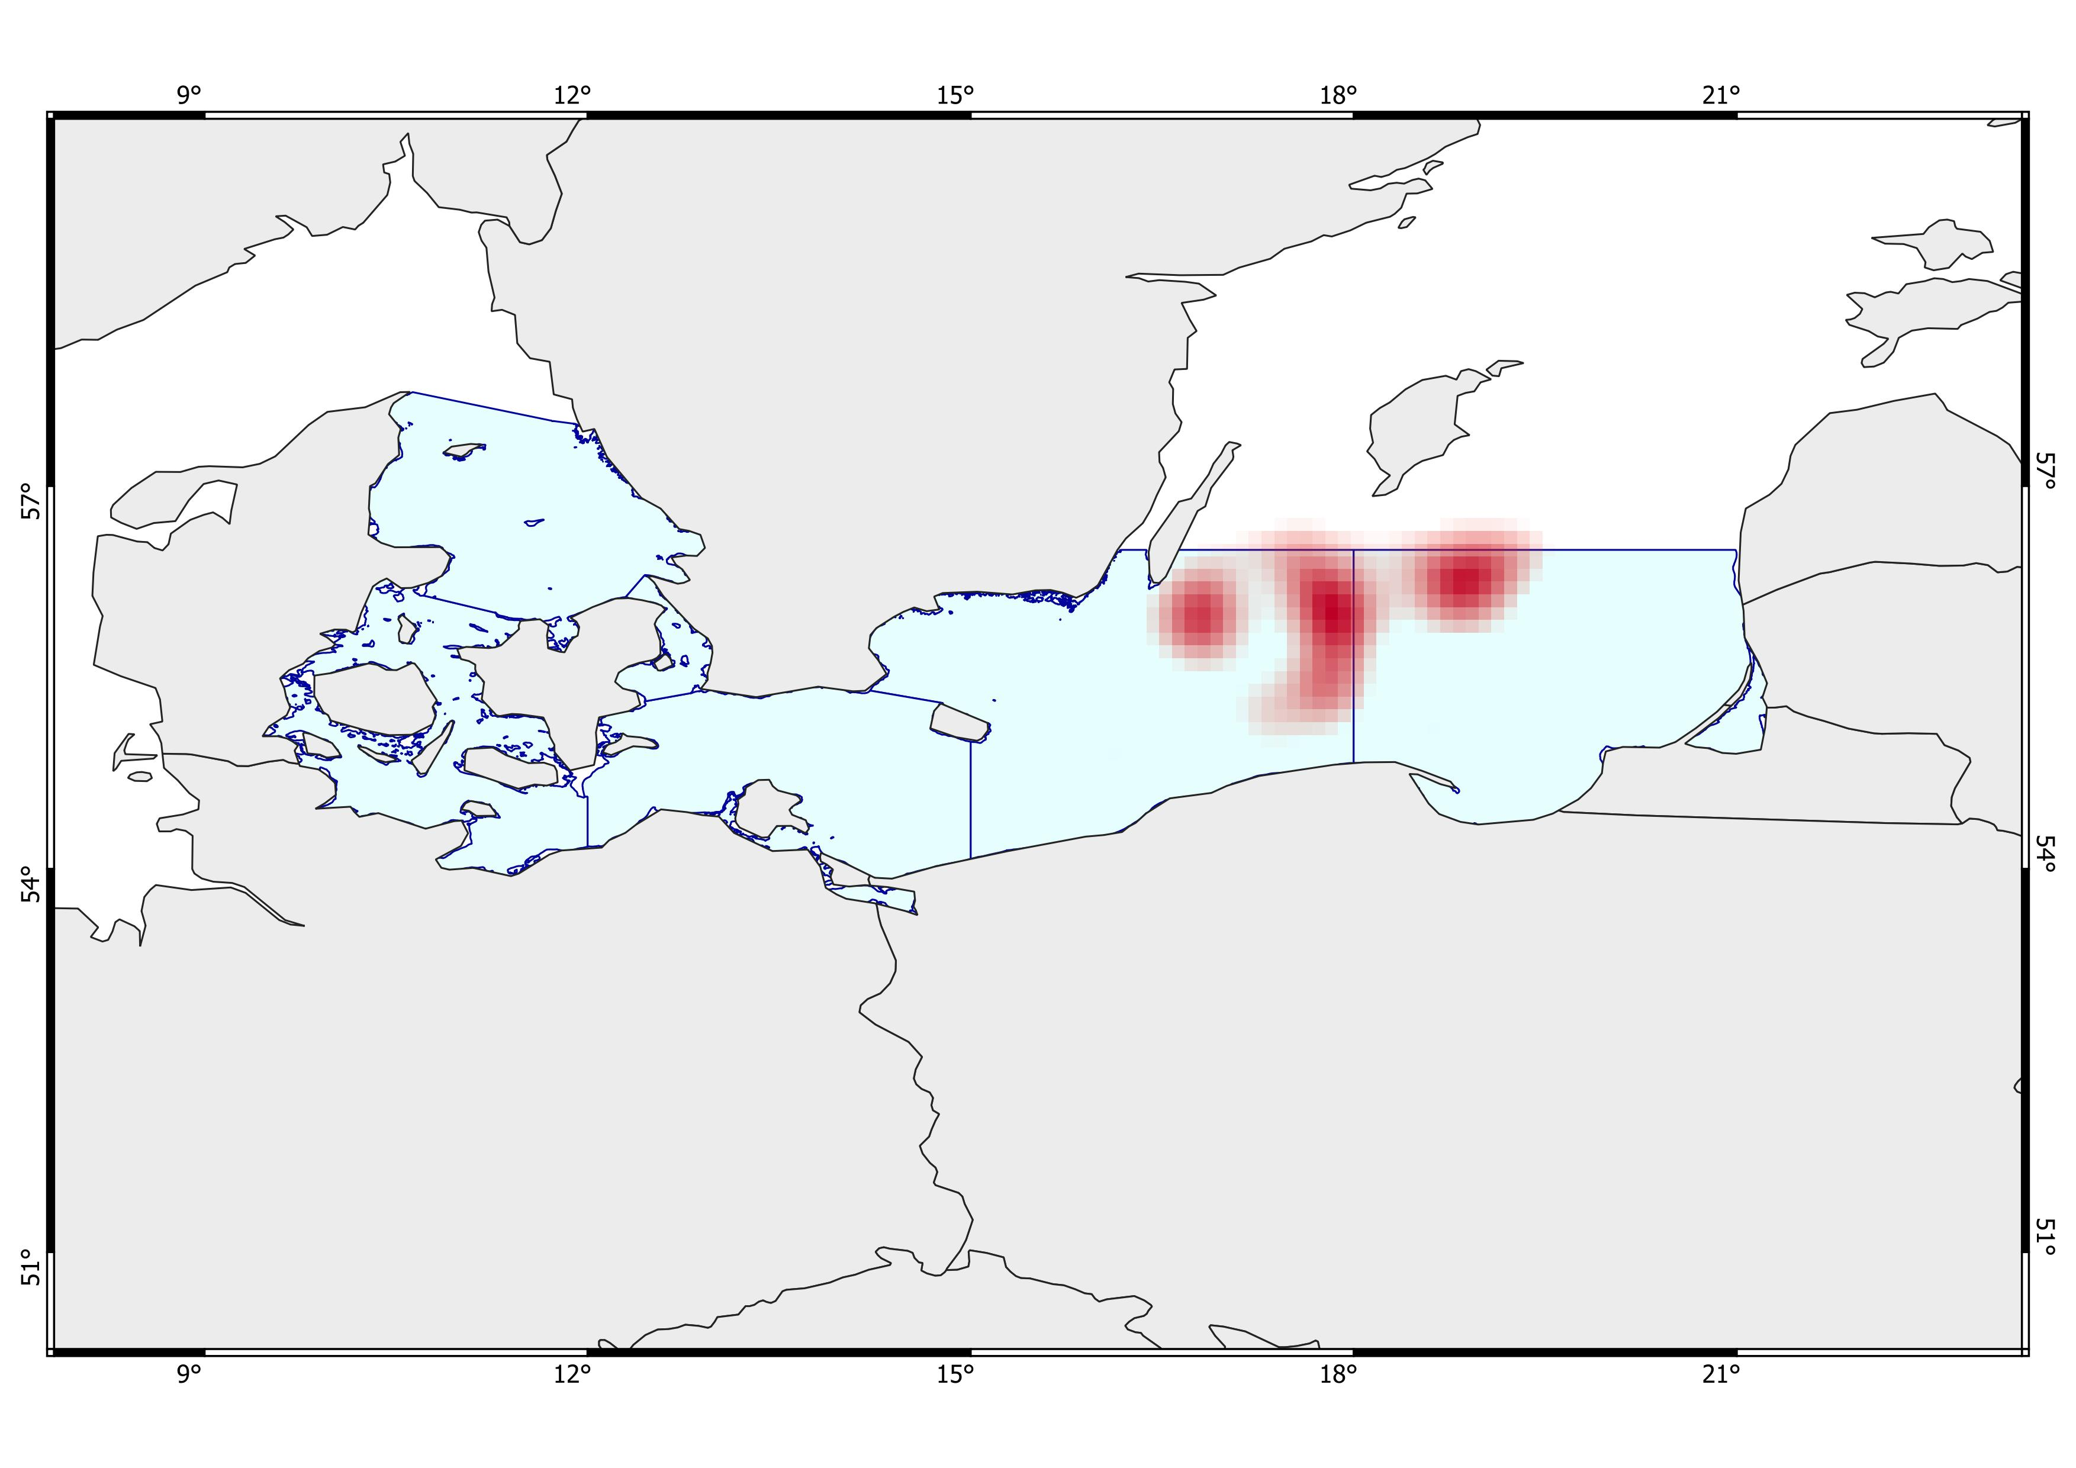
1
3
2
4
Ecosystem Risk Assessment
Multi K-means
- All species -
Deep, cold areas with very low bottom oxygen, moderate to high salinity, and low surface productivity. Very high biomass. Fishing activity is low to fair, and shipping traffic is moderate. Strong anthropogenic influence with a marked presence of dumping sites and very few wind farms.
Very deep, cold areas with extremely low bottom oxygen, low bottom salinity, and quite low surface productivity. Very high biomass. Fair to moderate fishing activity, and fair shipping traffic. Minor anthropogenic influence with the presence of wind farms.
Relatively shallow, very cold areas with moderately low bottom oxygen and very low bottom salinity, and low surface productivity. Very high biomass. Fair fishing activity and moderate shipping traffic. Moderate to high anthropogenic influence, with dumping sites and wind farms.
Very deep, cold areas with extremely low bottom oxygen and fair surface productivity. Very high biomass, low salinity, slightly high fishing activity, moderate shipping traffic, and the presence of wind farms.

Slide 15
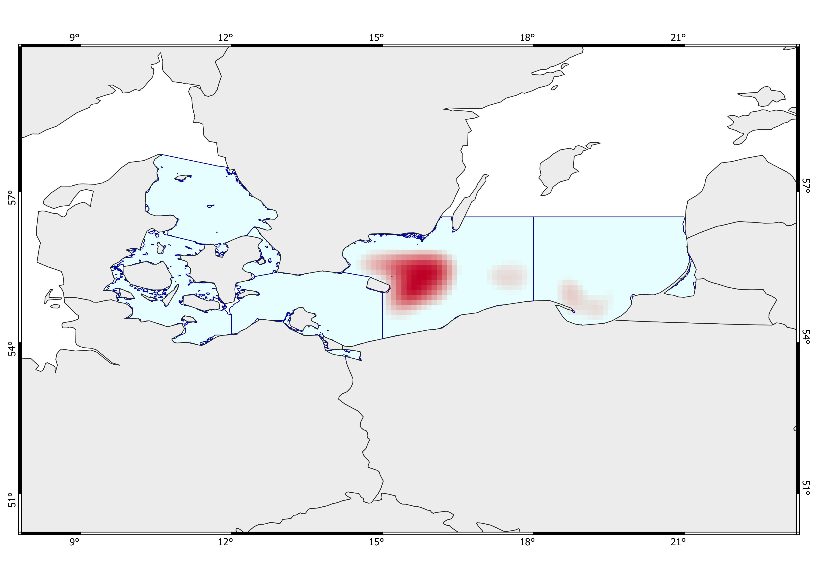
1
3
2
Ecosystem Risk Assessment
Multi K-means
- Five species -
Very deep, cold areas with extremely low bottom oxygen and very low surface productivity. Very high biomass of five commercial demersal species, high salinity, high fishing activity, and fair shipping traffic. Strong anthropogenic influence with a dominant presence of dumping sites and minor military areas and wind farms.
Very deep, cold areas with low bottom oxygen and fair surface productivity. Very high biomass of five commercial demersal species, extremely high fishing activity, moderate shipping traffic, and moderate salinity, with minor presence of military areas.
Very deep, cold areas with low bottom oxygen and fair surface productivity. Very high biomass of five commercial demersal species, very high fishing activity, moderate shipping traffic, and low/fair salinity.

Slide 16
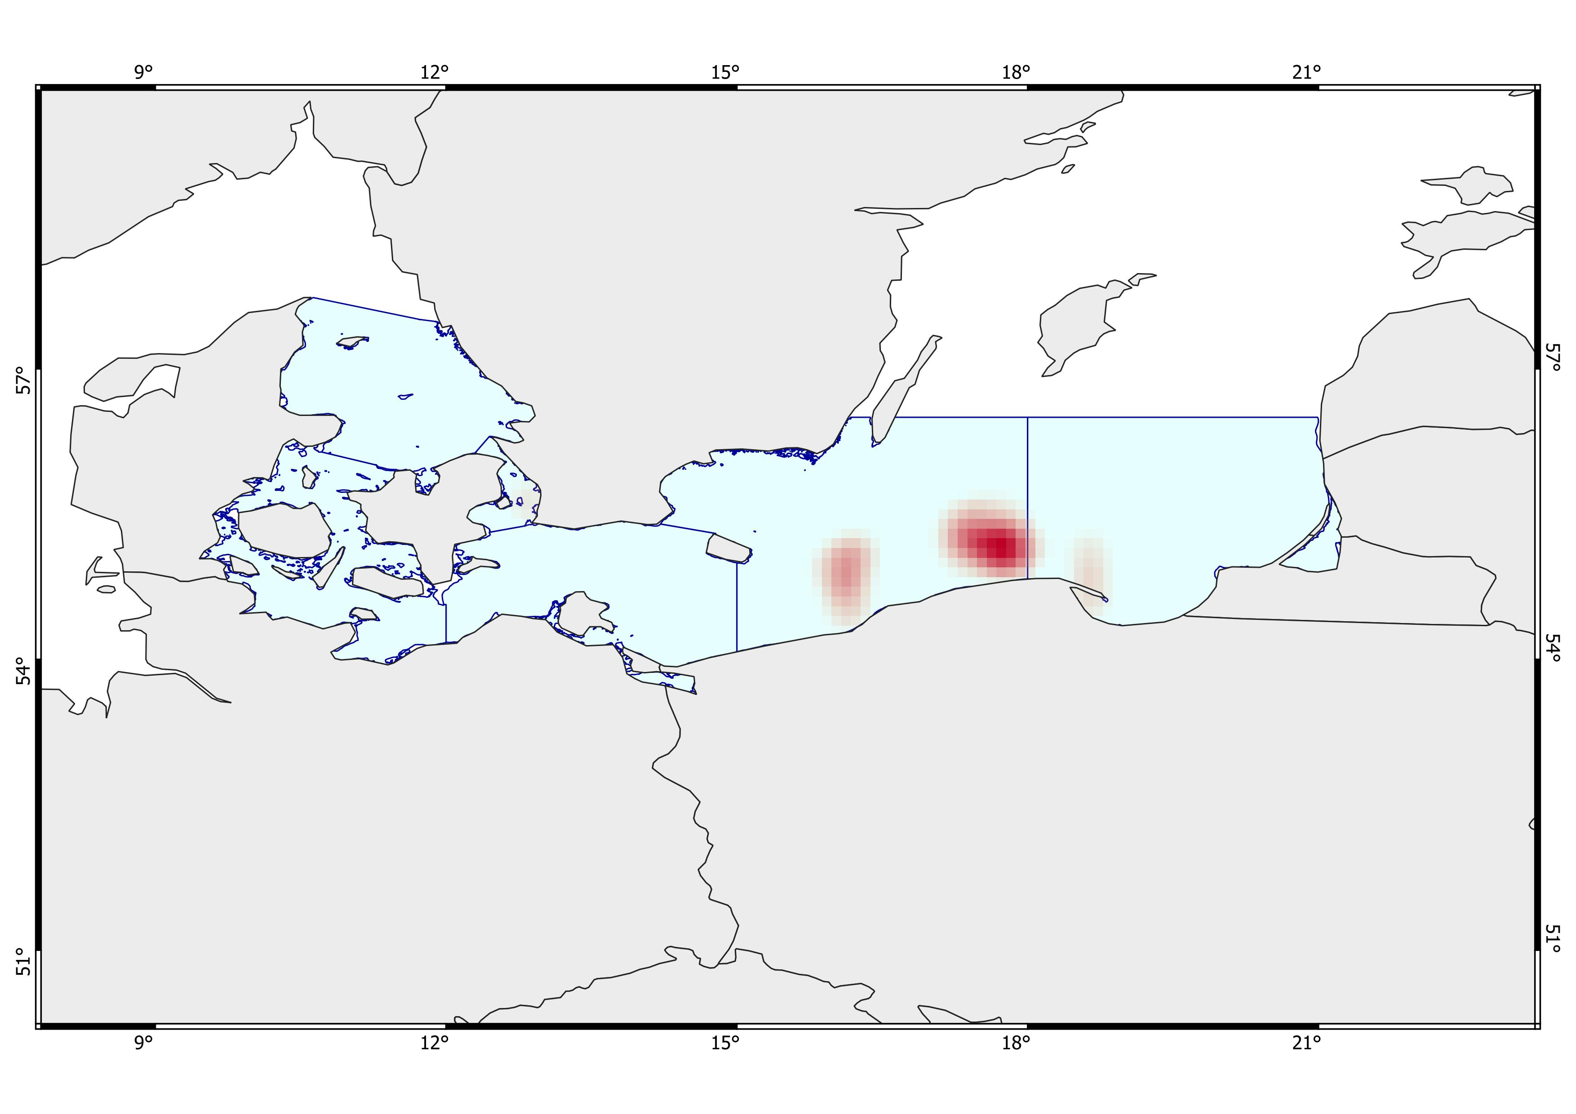
1
2
3
2
Ecosystem Risk Assessment
Multi K-means
- Gadus morhua -
Shallow, warm areas with slightly low bottom oxygen and very high surface productivity. Moderate to high biomass of Gadus morhua, moderately high fishing activity, moderate shipping traffic, and moderate salinity. Minor anthropogenic influence with light presence of dumping sites, military areas, and wind farms.
Fairly deep, cool areas with extremely low bottom oxygen and high surface productivity. High biomass of Gadus morhua, moderately high fishing activity, moderate shipping traffic, and fair salinity. Minimal presence of wind farms. Partly hardrock seafloor.
Fairly deep, cool areas with moderately low bottom oxygen and moderate surface productivity. High biomass of Gadus morhua, moderately high fishing activity, moderate shipping traffic, and fair salinity. Minimal anthropogenic influence, with only light presence of dumping sites, military areas, and wind farms. Partly hardrock seafloor.

Slide 17
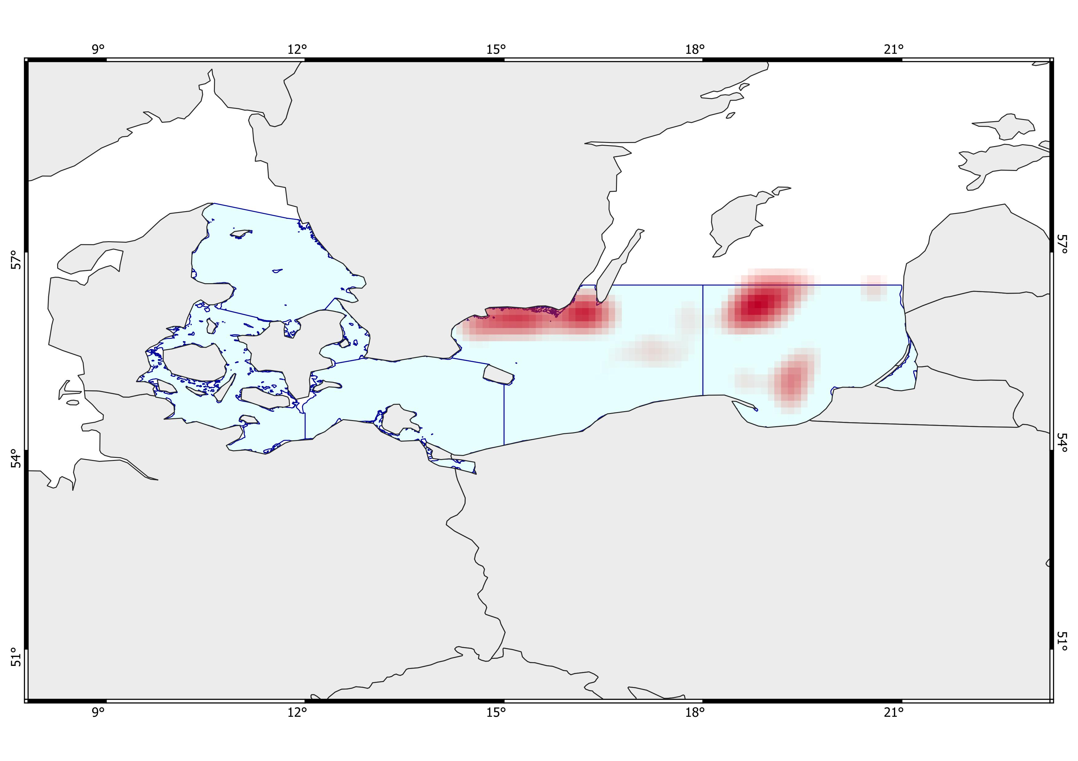
2
1
3
2
4
3
Ecosystem Risk Assessment
VAE (+ Multi K-means)
- All species -
Fairly deep, cold areas with high bottom oxygen and fairly moderate surface productivity. Very high biomass, moderately high fishing activity, moderate shipping traffic, and low salinity. Intense anthropogenic influence, limited to military areas. Partly hardrock seafloor.
Shallow areas with cool bottom waters, very high biomass, and moderate surface productivity. Moderately high fishing activity, moderate shipping traffic, and low salinity, with high bottom oxygen levels. Intense anthropogenic influence, limited to military areas.
Deep, cold areas with low bottom oxygen and low surface productivity. Very high biomass, moderate fishing activity, moderate shipping traffic, and moderate to high salinity. Strong presence of dumping sites and only minimal military influence.
Fairly deep, cold areas with low bottom oxygen and moderate surface productivity. High biomass, moderate to high fishing activity, high shipping traffic, and low salinity. Minimal presence of wind farms.

Slide 18
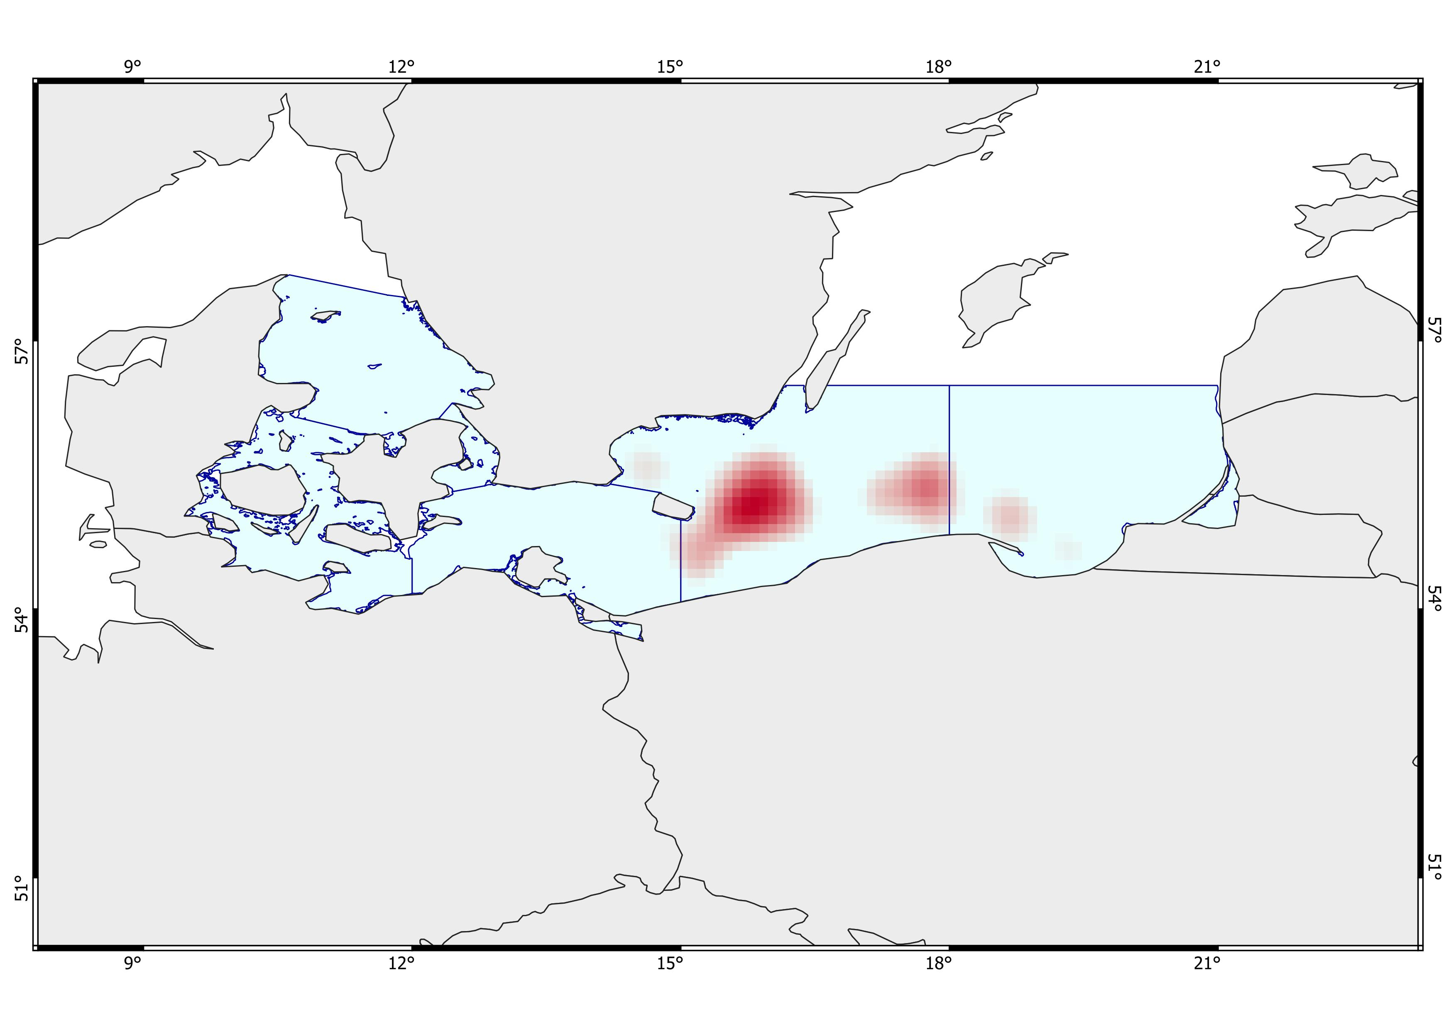
2
1
3
1
Ecosystem Risk Assessment
VAE (+ Multi K-means)
- Five species -
ABC…..
Deep, cold areas with low bottom oxygen and high salinity, and fairly high surface productivity. Very high biomass of five commercial species, intense fishing activity, and moderate shipping traffic. Strong anthropogenic influence with dominant dumping sites, military areas, and minimal presence of wind farms.
Shallow, cool areas with low bottom oxygen and moderately high salinity, and moderate surface productivity. High biomass of five commercial species, intense fishing activity, moderate shipping traffic. Minimal anthropogenic influence, limited to minor military areas and wind farms.
Deep, cold areas with low bottom oxygen and moderately high salinity, and moderate to high surface productivity. High biomass of five commercial species, intense fishing activity, moderate shipping traffic. Minimal anthropogenic influence, with only minor wind farms, and partly hardbottom seafloor.

Slide 19

3
2
1
4
Ecosystem Risk Assessment
VAE (+ Multi K-means)
- Gadus morhua -
Deep, very cold areas with extremely low bottom oxygen, moderately high salinity, and high surface productivity. High biomass of Gadus morhua, very intense fishing activity, and heavy shipping traffic.
Deep, very cold areas with high salinity, extremely low bottom oxygen, and high surface productivity. High biomass of Gadus morhua, intense fishing activity, and heavy shipping traffic, with only minimal hard-bottom substrate present.
Deep, cold areas with low bottom oxygen and high salinity, and fairly high surface productivity. Very high biomass of Gadus morhua, very intense fishing activity, and moderate shipping traffic. Strong anthropogenic influence with dominant dumping sites, military areas, and minimal presence of wind farms.
Deep, very cold areas with moderately high salinity, extremely low bottom oxygen and very high surface productivity. High biomass of Gadus morhua, very intense fishing activity and heavy shipping traffic, with only minimal anthropogenic presence from limited military areas.

Slide 20
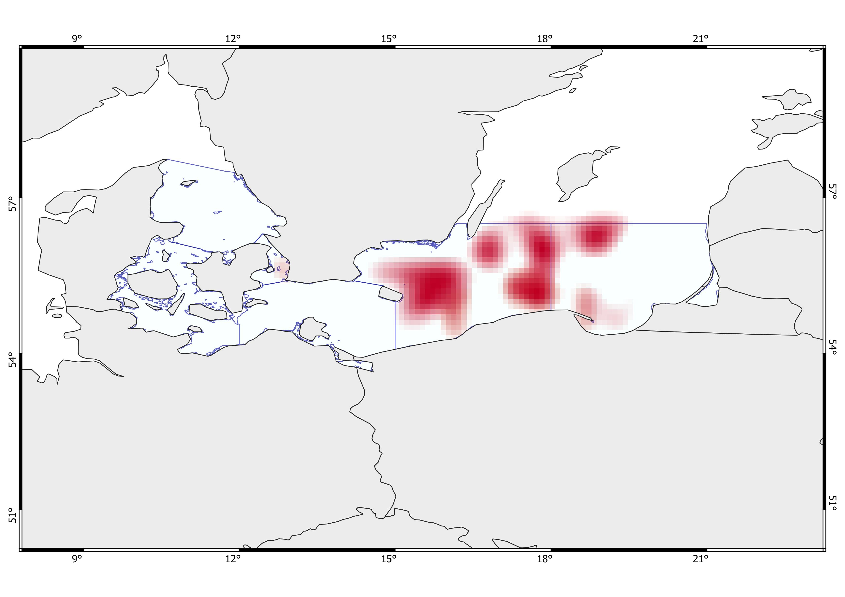
Shallow, warm areas with moderate bottom oxygen, very high salinity, and very high surface productivity. High biomass across the general biodiversity, including Gadus morhua. Moderate fishing activity and moderate to high shipping traffic. Minor anthropogenic influence with minimal presence of wind farms, dumping sites, and military areas. Limited bedrock seabed.
Very deep areas that become shallower toward the southern coast, moderately cold areas, moderate surface productivity, and extremely low bottom oxygen in the central zone, with less severe depletion near the Southern coast. Moderately high salinity. Biomass is generally moderate, high for the five commercially important species, including Gadus morhua. High to very high fishing activity, and shipping traffic from moderate to fairly high. Strong anthropogenic influence with a marked presence of dumping sites and military areas. Limited hard-rock seabed.
Relatively shallow, very cold areas with moderately low bottom oxygen and very low bottom salinity, and low surface productivity. Biomass is generally very high, while the five commercially important species range from moderate to high. Fair fishing activity and moderate shipping traffic. Moderate to high anthropogenic influence, with dumping sites and wind farms.
Very deep, very cold areas with extremely low bottom oxygen, low bottom salinity, and quite low surface productivity. Overall biomass is high, biomass of the five commercially important species is moderate, and Gadus morhua biomass is high. Fishing activity ranges from fair to moderate, and shipping traffic is fair. Minor anthropogenic influence with the presence of wind farms.
Deep, cold areas with very low bottom oxygen, moderate to high salinity, and low surface productivity. Overall biomass is very high, while biomass of the five commercially important species and Gadus morhua is low. Fishing activity is low to fair, and shipping traffic is moderate. Strong anthropogenic influence with a marked presence of dumping sites and very few wind farms.
D
E
C
A
B
F
G
H
Ecosystem Risk Assessment
Multi K-means
- Ensamble -
1

Slide 21
Moderately deep to deep, cold areas with moderately low bottom oxygen and fair to high salinity, and moderate to high surface productivity. Overall biomass is high, with high biomass of the five commercially important species and Gadus morhua. Moderate fishing activity, and fair to moderate shipping traffic. Minor anthropogenic influence with the presence of wind farms. Partly hardbottom seafloor.
Deep, cold areas with moderate to high bottom oxygen depletion and fair to moderate salinity, and high surface productivity. Overall biomass is high, with high biomass of the five commercially important species and Gadus morhua. Fishing activity is high, and shipping traffic ranges from moderate to high. Strong anthropogenic influence with a marked presence of military areas. Minimal hard-bottom seafloor.
Deep, cold areas with very low bottom oxygen, moderate salinity, and high surface productivity. Overall biomass is very high, biomass of the five commercially important species is moderate, and Gadus morhua biomass is high. Fishing activity is very intense, and shipping traffic is fair. Strong anthropogenic influence with a marked presence of military areas.
D
E
C
A
B
F
G
H
Ecosystem Risk Assessment
Multi K-means
- Ensamble -
2

Slide 22
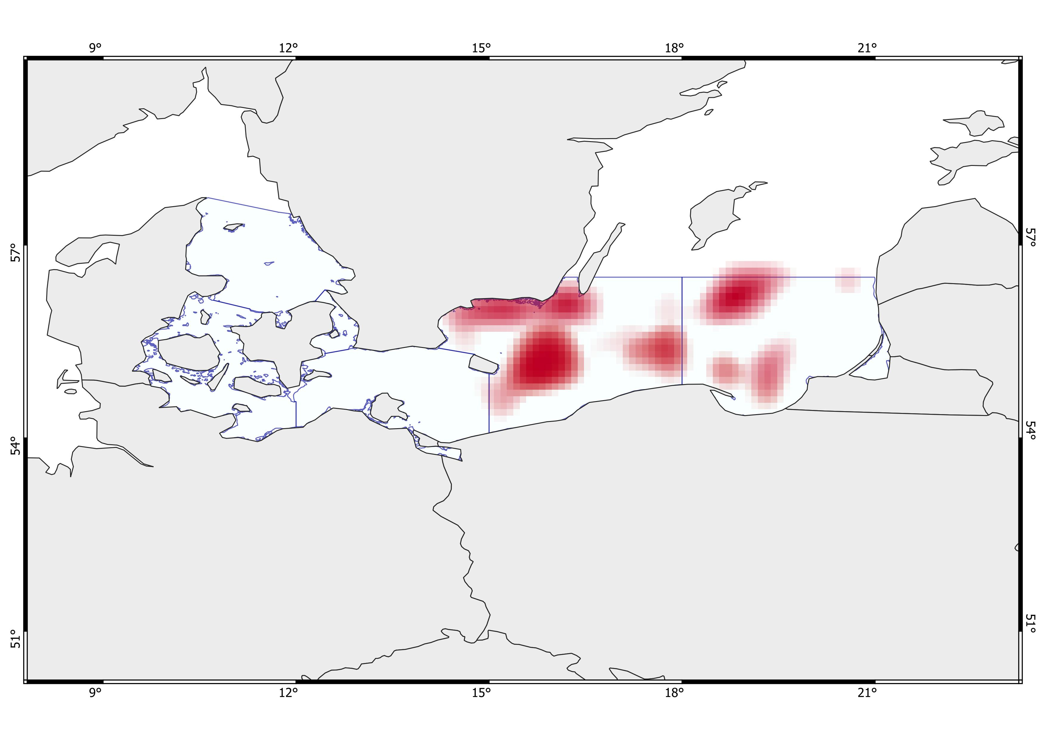
Moderately deep areas with cool to moderately cold bottom temperatures, low bottom salinity, and fair to moderate surface productivity. High bottom oxygen levels. Very high overall biomass, with high biomass of the five commercially important species. Moderate to high fishing activity and fair to moderate shipping traffic. Strong anthropogenic influence, with a marked presence of military areas. Partly hard-rock seafloor.
Moderately deep areas with cold bottom temperatures, low salinity, and low to fairly moderate surface productivity. High bottom oxygen levels. Very high overall biomass, low biomass of the five commercially important species, and moderate biomass of Gadus morhua. Fishing activity ranges from fair to high, and shipping traffic from fair to high. Strong anthropogenic influence with a marked presence of military areas. Presence of hard-bottom seafloor.
(E) Deep, cold areas with very low bottom oxygen, moderate to high salinity, and low surface productivity. Overall biomass is very high, while biomass of the five commercially important species and Gadus morhua is low. Fishing activity is low to fair, and shipping traffic is moderate. Strong anthropogenic influence with a marked presence of dumping sites and very few wind farms.
Shallow areas with moderately cold temperatures, moderate to high surface productivity, low salinity, and very high bottom oxygen levels. Overall biomass ranges from moderate to high, with moderate biomass of the five commercially important species, including Gadus morhua. Fishing activity is low, while shipping traffic is very intense. Strong anthropogenic influence with a marked presence of military areas. Partly hard-bottom seafloor.
E
O
M
N
L
Q
P
F
B
R
S
G
H
Ecosystem Risk Assessment
VAE (+ Multi K-means)
- Ensamble -
1

Slide 23
(B) Very deep areas that become shallower toward the southern coast, moderately cold areas, moderate surface productivity, and extremely low bottom oxygen in the central zone, with less severe depletion near the Southern coast. Moderately high salinity. Biomass is generally moderate, high for the five commercially important species, including Gadus morhua. High to very high fishing activity, and shipping traffic from moderate to fairly high. Strong anthropogenic influence with a marked presence of dumping sites and military areas. Limited hard-rock seabed.
(F) Moderately deep to deep, cold areas with moderately low bottom oxygen and fair to high salinity, and moderate to high surface productivity. Overall biomass is high, with high biomass of the five commercially important species and Gadus morhua. Moderate fishing activity, and fair to moderate shipping traffic. Minor anthropogenic influence with the presence of wind farms. Partly hardbottom seafloor.
(G) Deep, cold areas with moderate to high bottom oxygen depletion and fair to moderate salinity, and high surface productivity. Overall biomass is high, with high biomass of the five commercially important species and Gadus morhua. Fishing activity is high, and shipping traffic ranges from moderate to high. Strong anthropogenic influence with a marked presence of military areas. Minimal hard-bottom seafloor.
(H?) Very deep, cold areas with extremely low bottom oxygen, moderate salinity, and moderate to high surface productivity. Overall biomass is fairly moderate, with fair to low biomass of the five commercially important species and moderate biomass of Gadus morhua. Fishing activity is intense, and shipping traffic is high.
E
O
N
M
N
L
M
L
Q
P
Q
P
F
B
R
R
S
G
S
H
Ecosystem Risk Assessment
VAE (+ Multi K-means)
- Ensamble -
2

Slide 24
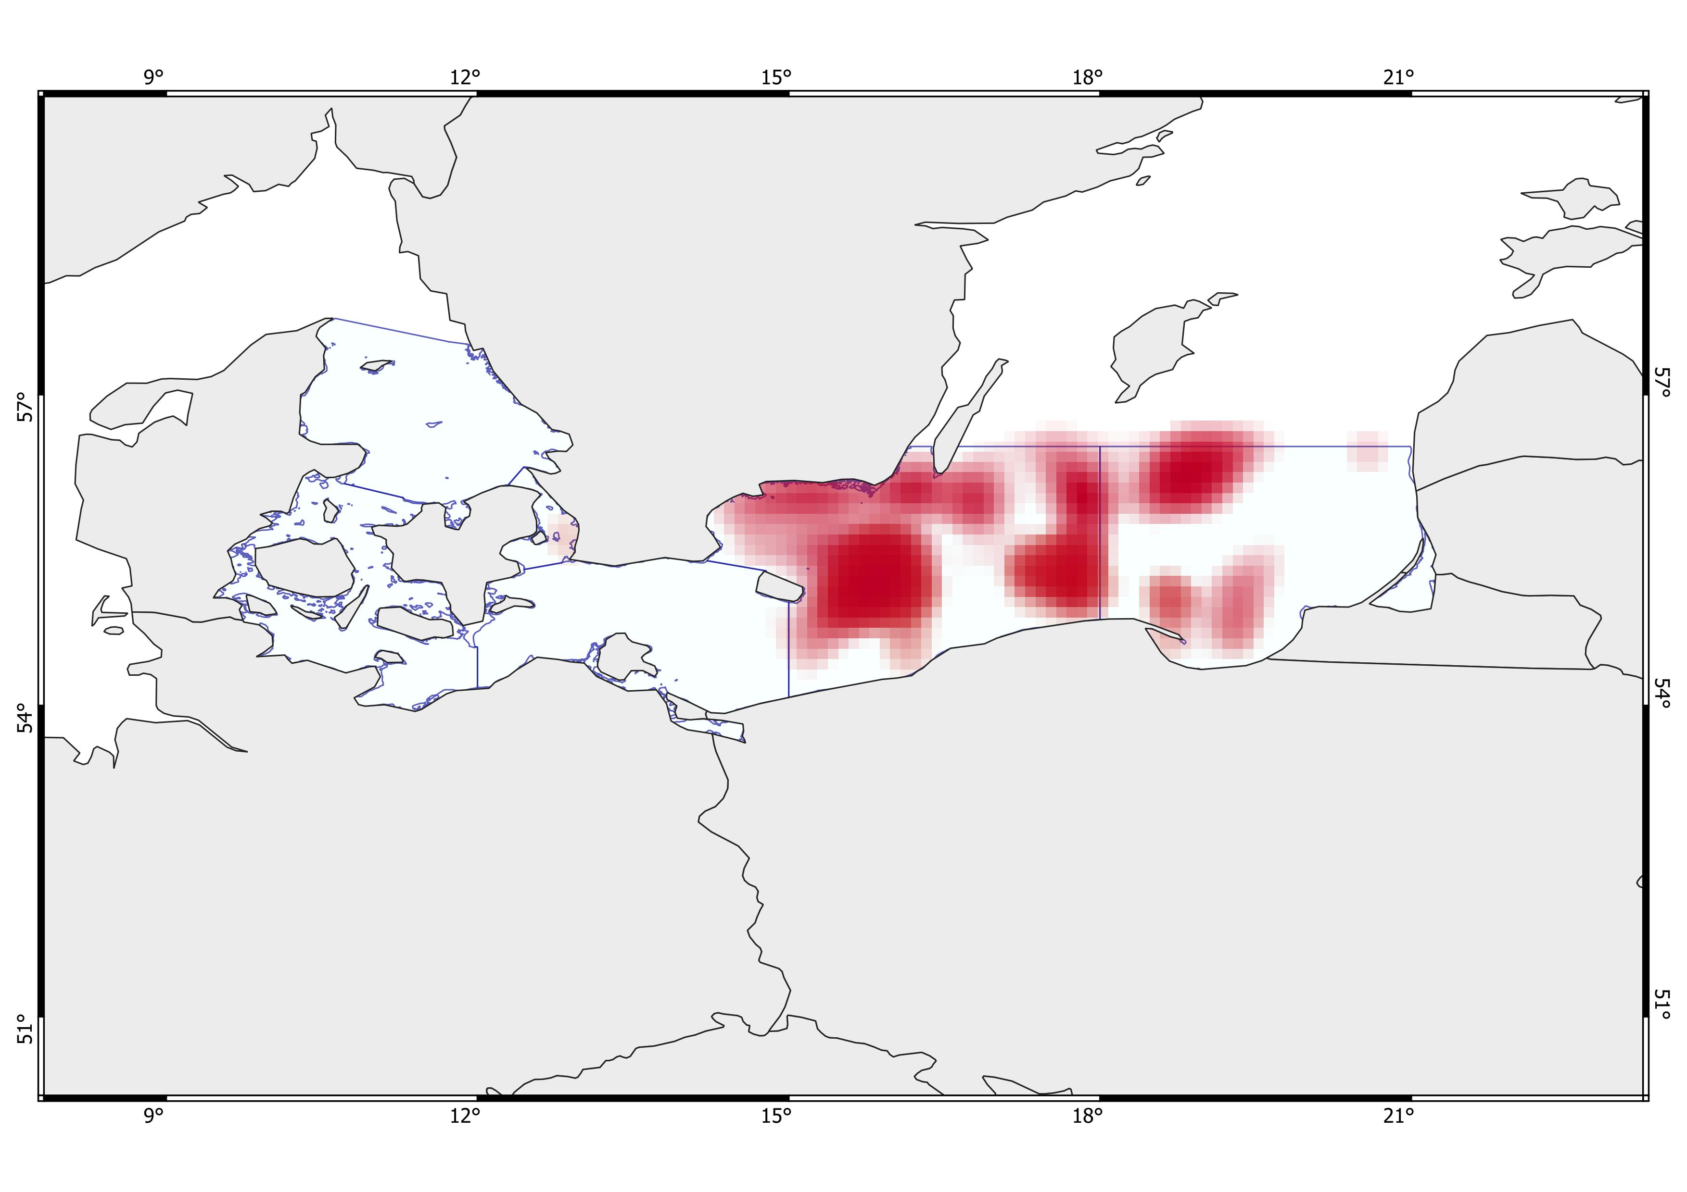
Shallow, warm areas with moderate bottom oxygen, very high salinity, and very high surface productivity. High biomass across the general biodiversity, including Gadus morhua. Moderate fishing activity and moderate to high shipping traffic. Minor anthropogenic influence with minimal presence of wind farms, dumping sites, and military areas. Limited bedrock seabed.
(P) Very deep areas that become shallower toward the southern coast, moderately cold areas, moderate surface productivity, and extremely low bottom oxygen in the central zone, with less severe depletion near the Southern coast. Moderately high salinity. Biomass is generally moderate, high for the five commercially important species, including Gadus morhua. High to very high fishing activity, and shipping traffic from moderate to fairly high. Strong anthropogenic influence with a marked presence of dumping sites and military areas. Limited hard-rock seabed.
Relatively shallow, very cold areas with moderately low bottom oxygen and very low bottom salinity, and low surface productivity. Biomass is generally very high, while the five commercially important species range from moderate to high. Fair fishing activity and moderate shipping traffic. Moderate to high anthropogenic influence, with dumping sites and wind farms.
Very deep, very cold areas with extremely low bottom oxygen, low bottom salinity, and quite low surface productivity. Overall biomass is high, biomass of the five commercially important species is moderate, and Gadus morhua biomass is high. Fishing activity ranges from fair to moderate, and shipping traffic is fair. Minor anthropogenic influence with the presence of wind farms.
(N) Deep, cold areas with very low bottom oxygen, moderate to high salinity, and low surface productivity. Overall biomass is very high, while biomass of the five commercially important species and Gadus morhua is low. Fishing activity is low to fair, and shipping traffic is moderate. Strong anthropogenic influence with a marked presence of dumping sites and very few wind farms.
E
O
L
M
C
D
N
A
B
Q
P
F
R
G
S
H
Ecosystem Risk Assessment
Multi K-means
&
VAE (+ Multi K-means)
- Ensamble -
1

Slide 25
(Q) Moderately deep to deep, cold areas with moderately low bottom oxygen and fair to high salinity, and moderate to high surface productivity. Overall biomass is high, with high biomass of the five commercially important species and Gadus morhua. Moderate fishing activity, and fair to moderate shipping traffic. Minor anthropogenic influence with the presence of wind farms. Partly hardbottom seafloor.
(R) Deep, cold areas with moderate to high bottom oxygen depletion and fair to moderate salinity, and high surface productivity. Overall biomass is high, with high biomass of the five commercially important species and Gadus morhua. Fishing activity is high, and shipping traffic ranges from moderate to high. Strong anthropogenic influence with a marked presence of military areas. Minimal hard-bottom seafloor.
Deep, cold areas with very low bottom oxygen, moderate salinity, and high surface productivity. Overall biomass is very high, biomass of the five commercially important species is moderate, and Gadus morhua biomass is high. Fishing activity is very intense, and shipping traffic is fair. Strong anthropogenic influence with a marked presence of military areas.
E
O
L
M
C
D
N
A
B
Q
P
F
R
G
S
H
….
….
…..
Ecosystem Risk Assessment
Multi K-means
&
VAE (+ Multi K-means)
- Ensamble -
…..
2

